Slide 1
MUSIC GENRE CLASSIFICATION
Eric Heidbreder | DSIR-720

Slide 2

01 | Problem
02 | Data
03 | EDA
04 | Modeling
05 | Pop Quiz
06 | Conclusions

Slide 3
Problem Statement

Slide 4
PROBLEM STATEMENT
Using features derived from an audio source, can a classification model predict the genre of a 30-second audio clip with high enough accuracy to organize songs into their respective genres?

Slide 5
WHO CARES?
Classifying genre is important for music distribution and streaming platforms. Automating the process would save time and money.
Assigning genre properly allows listeners find new artists they might like, and, in turn, helps musicians connect with new audiences via genre-based playlists.

Slide 6
The Dataset

Slide 7
9365 Songs
30-second audio samples pulled from Spotify.
Spotify API gives access to:
General song metadata
Pre-engineered features

Slide 8
What are the genres?
5-genre set
Classical
Rock
Rap
R&B
Progressive Bluegrass
10-genre set (orig. 5 plus)
Baroque
Serialism
Hip Hop
Pop
Tropical House

Slide 9
Issues with the data?
One song, multiple genres
Genre connected to artist instead of song
Some songs have no 30-sec preview
Some track names contain non-English characters
Unbalanced classes
Notes:
Genre connected to artist – Billy Ray Cyrus and Old Town Road, Billy Ray Cyrus is not considered a rap artist, so this would probably throw our model off

Slide 10
EDA

Slide 11
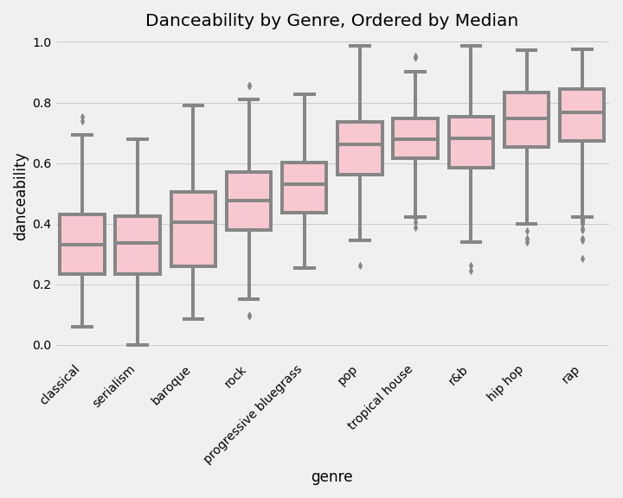
Danceability
Notes:
Calculated feature combining different elements of rhythm.
Note that there range of values is fairly large, but pop, house, r&b, hip hop, and rap score higher on the danceability scale, which is what you’d expect!

Slide 12
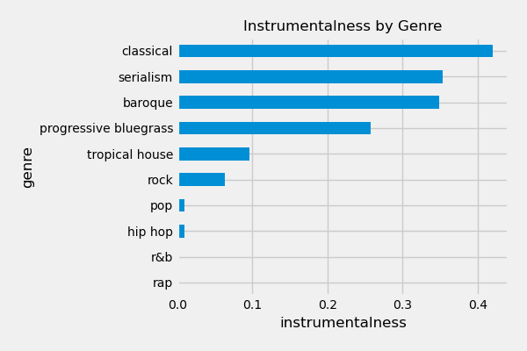
Instrumentalness
Notes:
Instrumentalness takes into account how much of the song does not contain vocals (oooh and ahhhs were not counted as vocals for this). Again, these features behave as expected, since classical, serial, and baroque pieces tend to focus more on instruments, while rock, pop, hip hop, r&b, and rap tend to have more lyrical content.

Slide 13
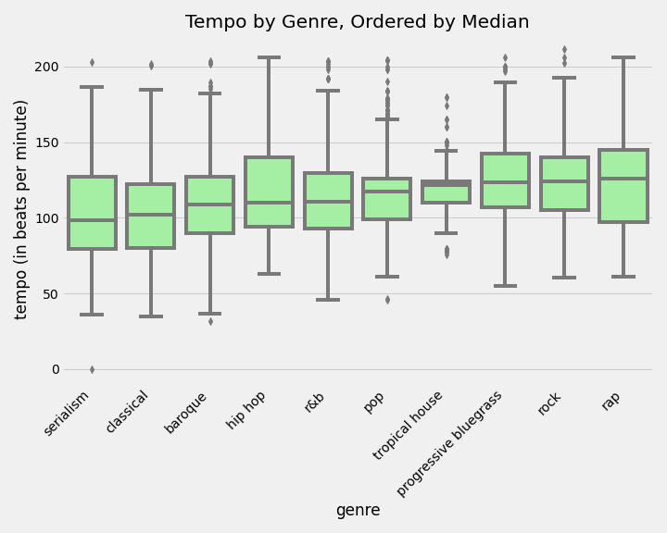
Tempo

Slide 14
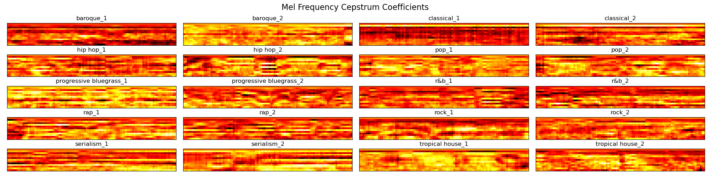
Mel Frequency Cepstral Coefficient (MFCC)
Notes:
A lot of different time-series calculations go on behind the scenes here, but ultimately this creates a non-linear representation of a sound’s spectrum. Think of it like a sonic fingerprint. This is the visual representation of what the mfcc looks like. It’s hard to tell the difference between these with such a small sample size, but there’s a lot of information packed into this one feature.

Slide 15
Modeling

Slide 16
What model did we use?
SVC
Good training/testing accuracy
Takes seconds to fit model
CON: Does not scale well to large datasets
Convolutional Neural Net
Similar training/testing accuracy as SVC
Large dataset (>3 GB)
CON: Can’t compare Spotify features to newly-extracted features.

Slide 17
What model did we use?
SVC
Good training/testing accuracy
Takes seconds to fit model
CON: Does not scale well to large datasets
Convolutional Neural Net
Similar training/testing accuracy as SVC
Large dataset (>3 GB)
CON: Can’t compare Spotify features to
newly-extracted features.

Slide 18
What features did we create?
Volume/Loudness
Energy
Root Mean Squared Energy
Power across frequency spectrum
MFCC

Slide 19
Baseline model and Metrics
Metric
Accuracy
Baseline Model
5-genres: 20%
10-genres: 10%

Slide 20
Model Comparison: Spotify features vs. extracted features
# of Genres | Acc (Spotify features) | Acc (extracted features)
5 | 78.4% | 84.2%
10 | 50.6% | 56.5%
5.85%
Mean Improvement when compared to Spotify features

Slide 21
Pop
Progressive Bluegrass
10-Genre Classifier Breakdown
Genre predicted correctly least often by both models (Spotify: 14.4%, Extracted: 17.6%)
Genre predicted correctly most often by both models (Spotify: 77.6%, Extracted: 84%)

Slide 22
Pop Quiz (or maybe Tropical House Quiz)

Slide 23

Digging in - why is our model confused?
What genre would you classify this as?
Pop
Classical
Tropical House

Slide 24
Digging in - why is our model confused?
What genre would you classify this as?
Pop → Predicted Genre
Classical
Tropical House → Correct Genre!
Drums not as heavy as other Tropical House tracks?

Slide 25
Digging in - why is our model confused?
What genre would you classify this as?
Rock
Progressive Bluegrass
Tropical House

Slide 26
Digging in - why is our model confused?
What genre would you classify this as?
Rock → Correct Genre!
Progressive Bluegrass
Tropical House → Predicted Genre
Dynamic Contrast and “Drops” in Tropical House Music

Slide 27
Digging in - why is our model confused?
What genre would you classify this as?
Rap
Tropical House
Hip Hop

Slide 28
Digging in - why is our model confused?
What genre would you classify this as?
Rap → Correct Genre!
Tropical House → Predicted Genre
Hip Hop
Bad 30-second draw, the hook of this Rap song seems to be inspired by Tropical House genre

Slide 29
Conclusions

Slide 30
CONCLUSIONS
Good things
Our extracted-features model is outperforming the baseline as well as a similar model trained on Spotify’s features.
When predicting wrong, the models tend to predict related genres.
Bad things
~56% accuracy is not good enough to automatically assign genre on a large scale. We’d wind up with a lot of misclassified genres and confused listeners.
What I learned
Sub-genres are not very well defined at the sonic level. There are likely other factors that go into the creation of sub-genre. (Artist location, lyrical content, instrumentation)

Slide 31

Future Steps
Manually assign genres per song
Instrument extraction
Unsupervised learning for more accurate genres

Slide 32
SOURCES
Presentation template by SlidesCarnival
Photographs by Unsplash
https://musicinformationretrieval.com/energy.html
https://musicinformationretrieval.com/mfcc.html
Sahidullah, Md.; Saha, Goutam (May 2012). "Design, analysis and experimental evaluation of block-based transformation in MFCC computation for speaker recognition". Speech Communication. 54 (4): 543–565. doi:10.1016/j.specom.2011.11.004.
Adams, Seth. “DSP Background – Deep Learning for Audio Classification”. https://www.youtube.com/watch?v=Z7YM-HAz-IY&list=PLhA3b2k8R3t2Ng1WW_7MiXeh1pfQJQi_P

Slide 33

THANKS!
Any questions?

